Slide 1
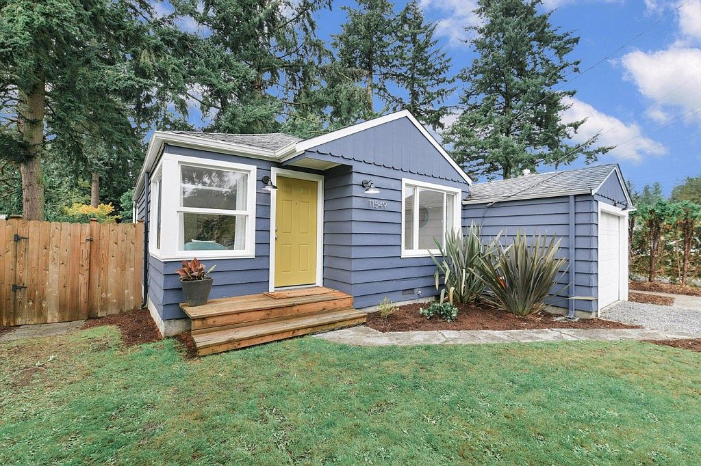
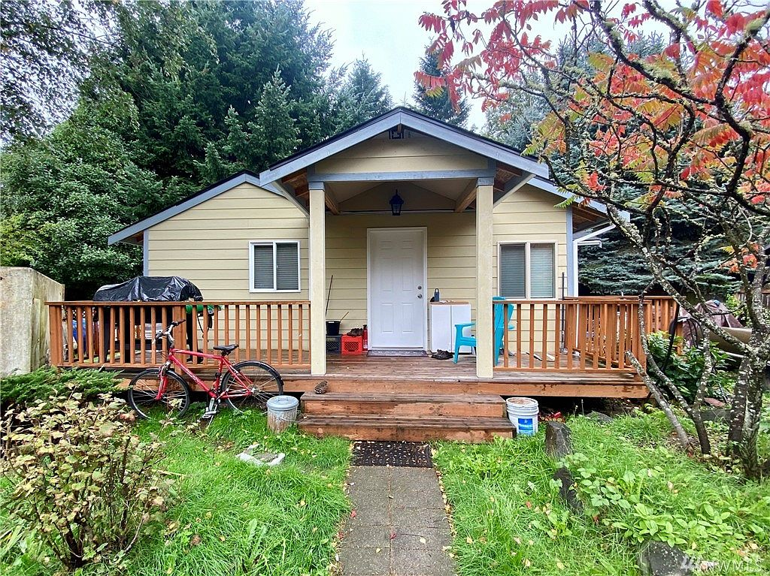
Predicting Housing Prices in King County, WA
November 2020 Mark, matt, Mel

Slide 2
Context

Slide 3

M3 Consulting
“Helping good people find affordable homes.”
Working with several non-profit groups in King County, WA:
What features help predict home price (under $500K)?
What features can be minimized to bring down home price?
Where in King County should new buyers look for affordable homes?

Slide 4
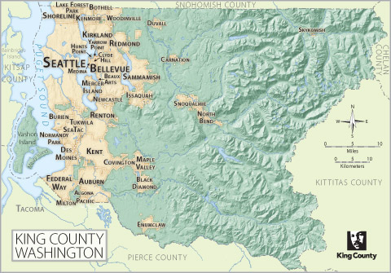
Understanding the Context
King County, WA:
Population (2010): 1.9 million
HH Income (2014): $75K
Median home value (2014-2018): $494K
Tech boom of the 2000 has created one of the most expensive housing markets in the country
In a recent survey, the top feature buyers said they want most:
“a home that is within my initial budget” (89%)

Slide 5

Meet the Salazar family
“We want a home we can afford, and that will be a safe place for our kids to grow.”
Currently renting an apartment
Looking to buy their first home
HH Income of $75K
Assuming a $10K down payment, they can afford a $316K home*
*based on an affordability calculator

Slide 6
Data

Slide 7
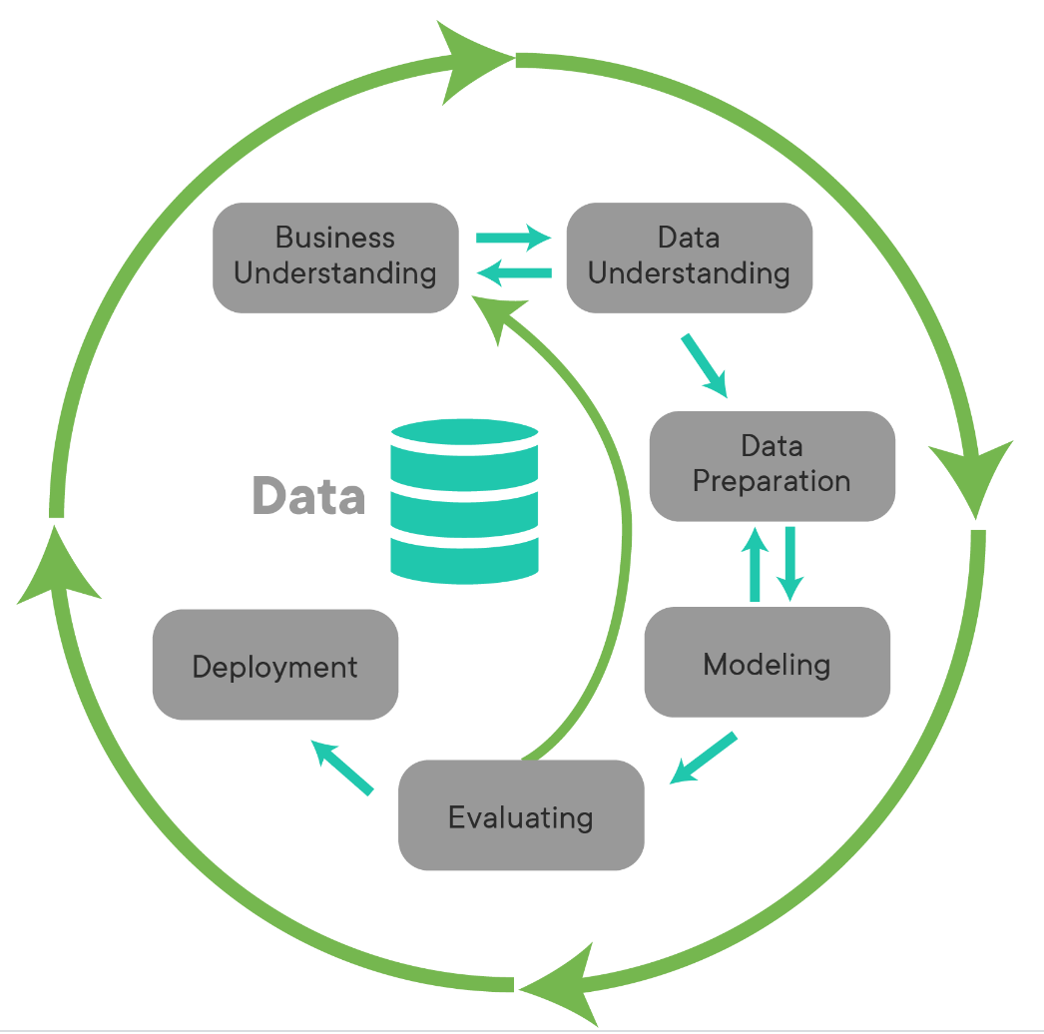
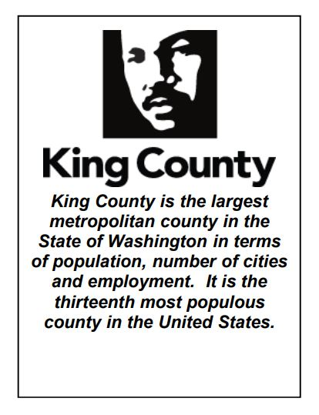
Exploring the Data
Housing Sales Data:
Data provided by King County Assessors Office
Home sales: May 2014 to May 2015
~ 21,000 records
21 variables
Our Process*:
* This process is called CRISP-DM

Slide 8
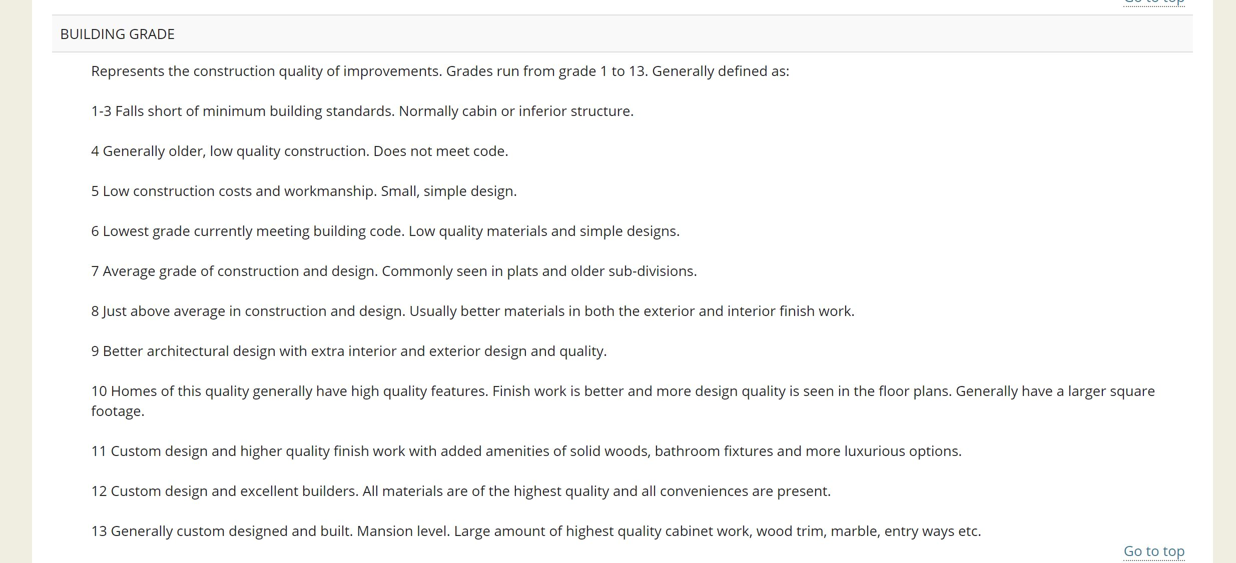
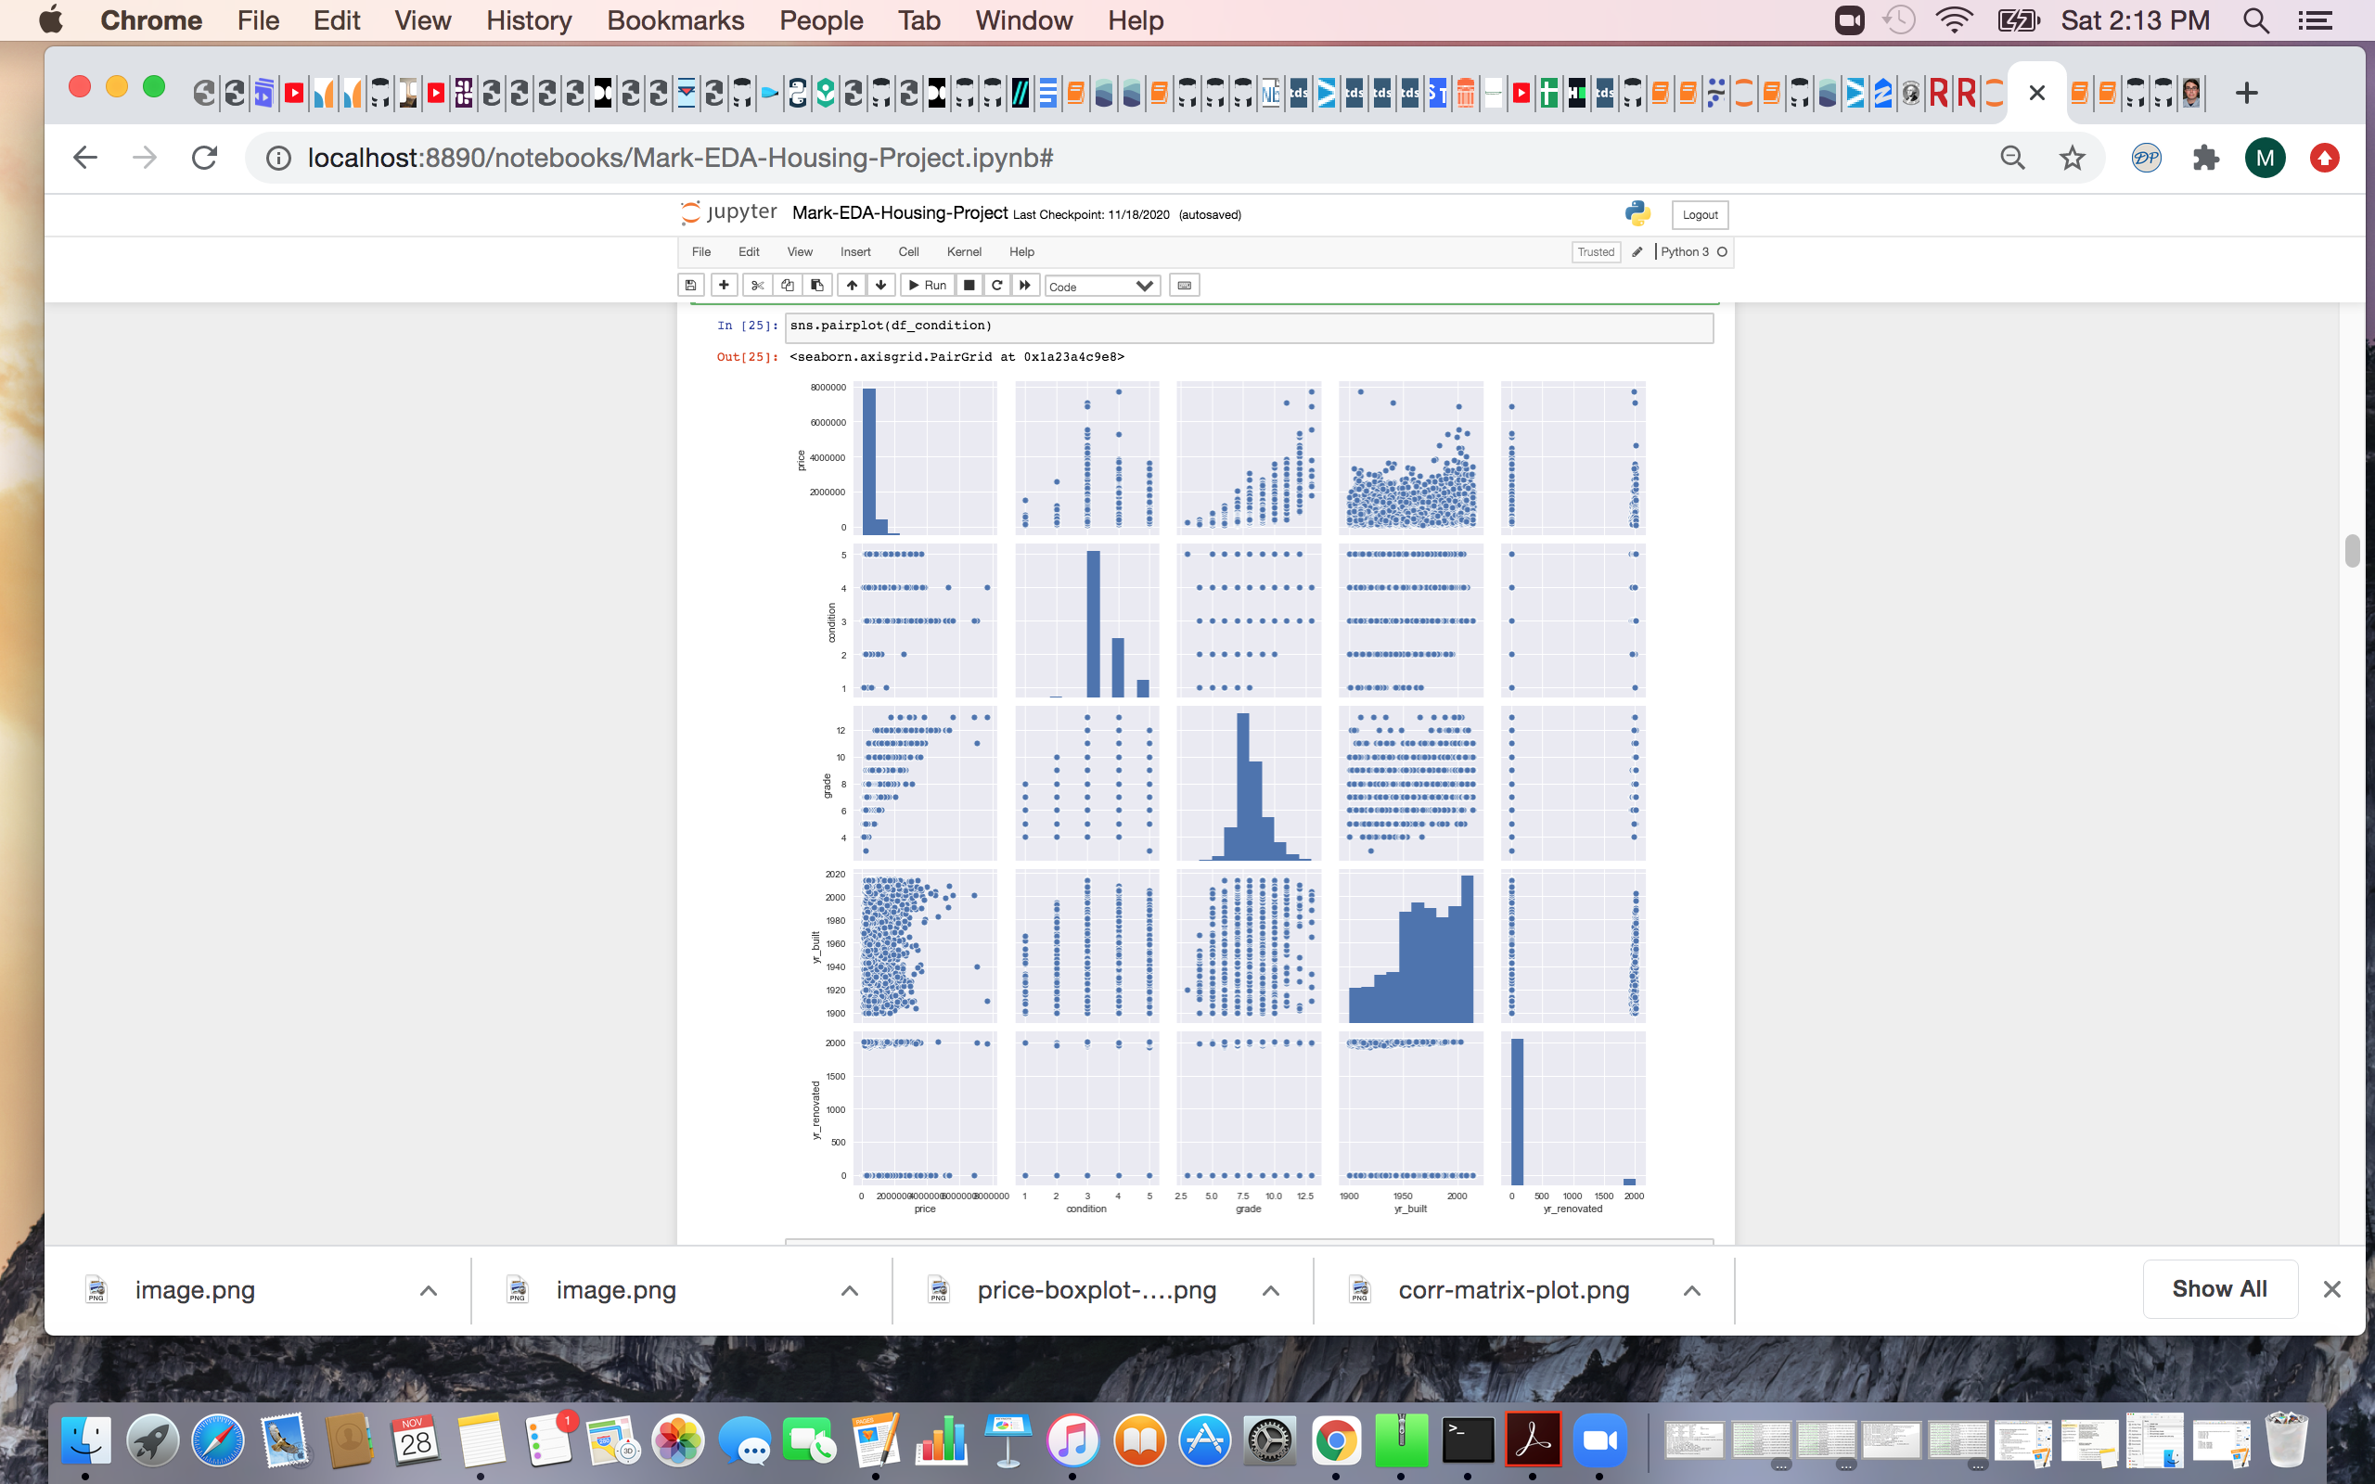
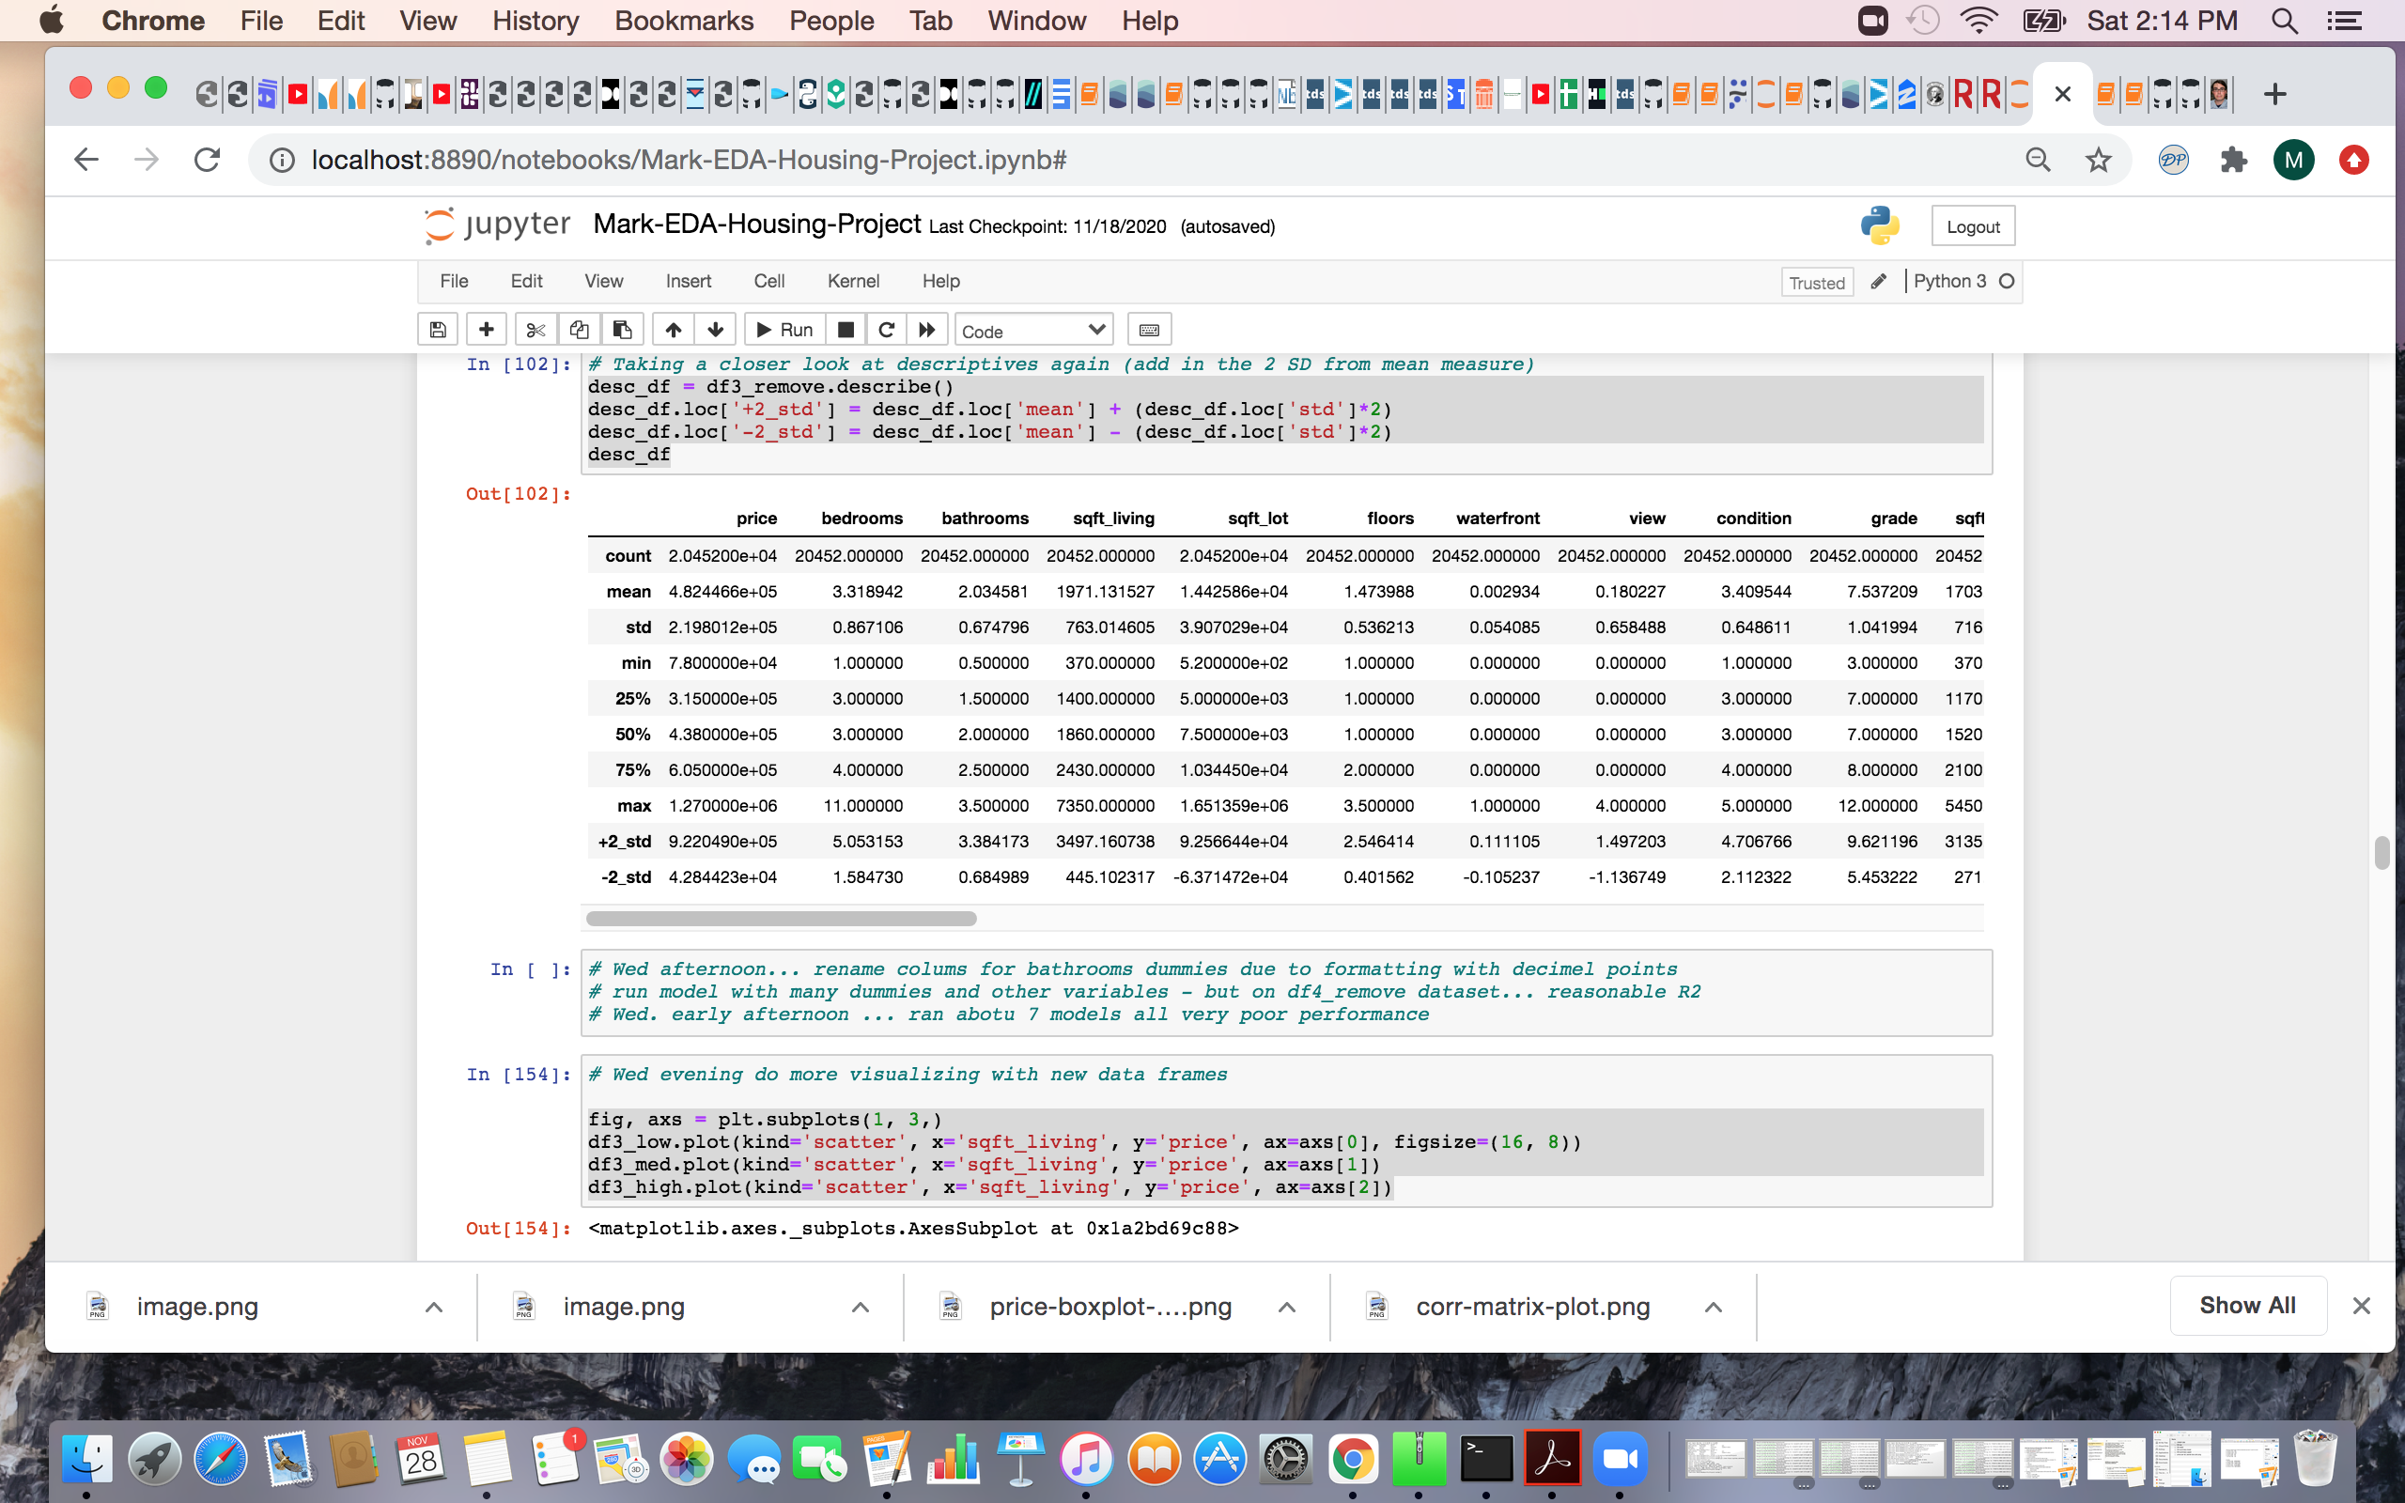
Our Data Journey
Researched features
Visualized and looked at descriptive statistics
Examined distributions
Looked for linear relationships
Formated features as numbers; null values turned into 0’s
Removed un-used features (zip code, date, longitude)
Checked for duplicates

Slide 9
Modeling

Slide 10
Our Modeling Journey
A) Mid-priced
B) Low-priced
C) Adjust features
D) Add latitude
Limited price: $315K to $605K (7 models; r2~0.10)
Limited price: $154K to $315K (8 models; r2~0.19)
Tried adjusting scales of most features (min-max) and logged grade. (3 models; r2~0.20)
Added in latitude (bands) and this helped. Broadened price to $453K. (4 models; r2~0.492)

Slide 11
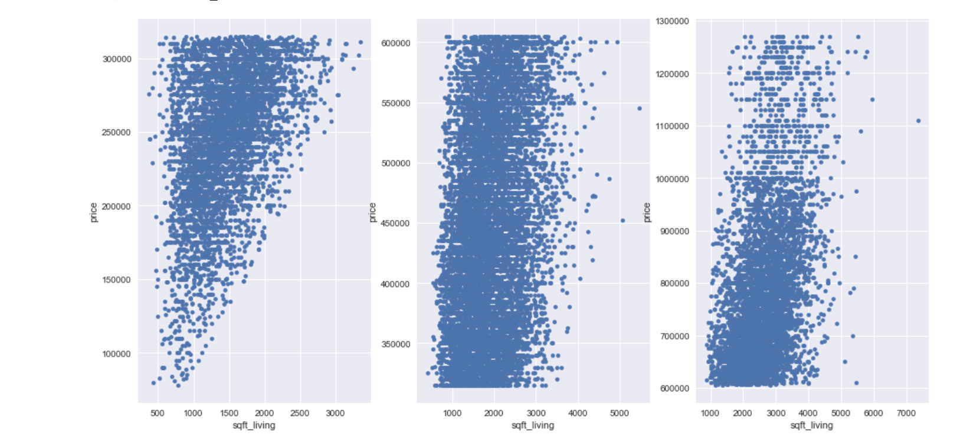
Low-priced shows clearer linear relationship
Low-priced (up to $314K)
Mid-priced ($315K to $605K)
High-priced ($606K and up)
Re-examining scatter plots led us to shift from mid-priced homes to low-priced homes

Slide 12
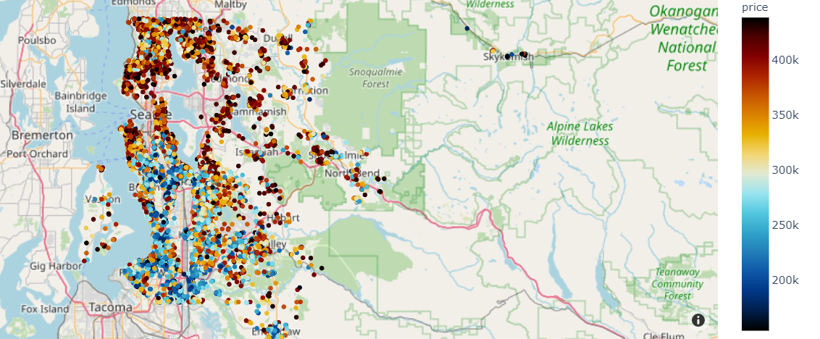
Location, location, location…
Plotting home sales on a map revealed an important pattern in our data (latitude more pronounced differences than longitude)

Slide 13
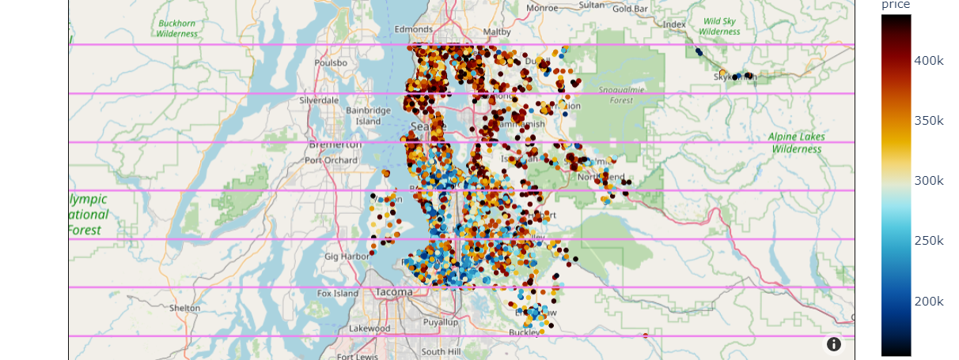
Created 6 bands for latitude
lat_6
lat_5
lat_4
lat_3
lat_2
lat_1
From the bands, created separate “dummy” features (lat_1 to lat_6)*.
* Note that lat_1 was “dropped” from the predictor set.

Slide 14
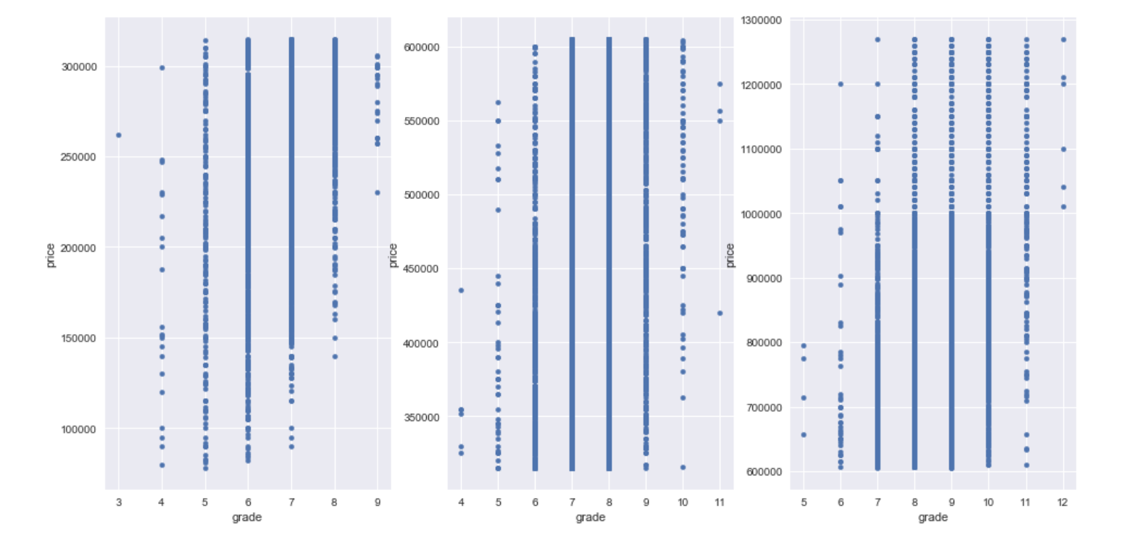
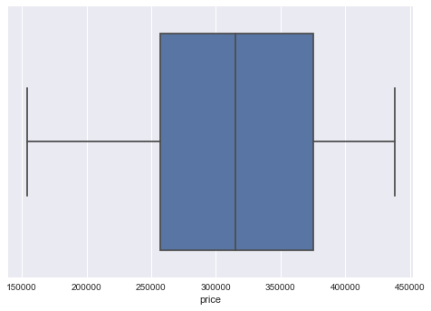
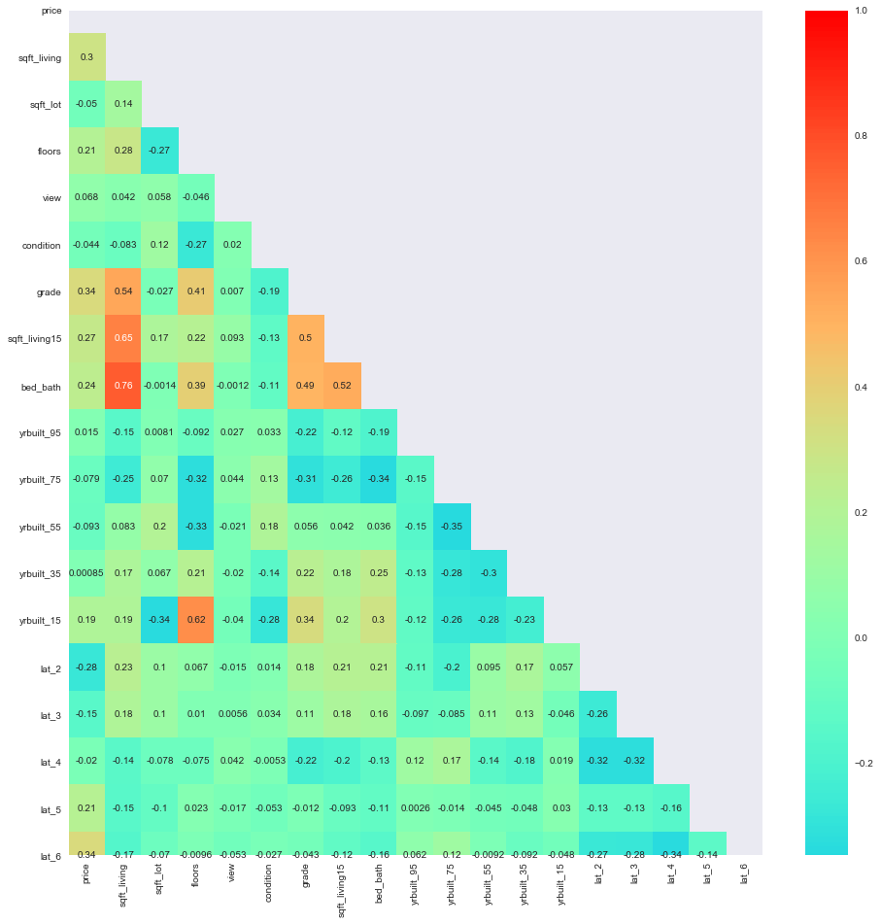
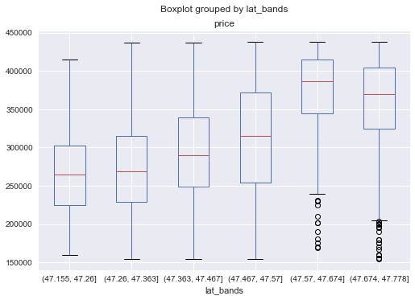
Model Adjustments
Removed outliers
Created banding and "dummy” variables (latitude; year built)
Created new variables (bed and bath combined)
Didn’t include highly related features
Removed insignificant features

Slide 15
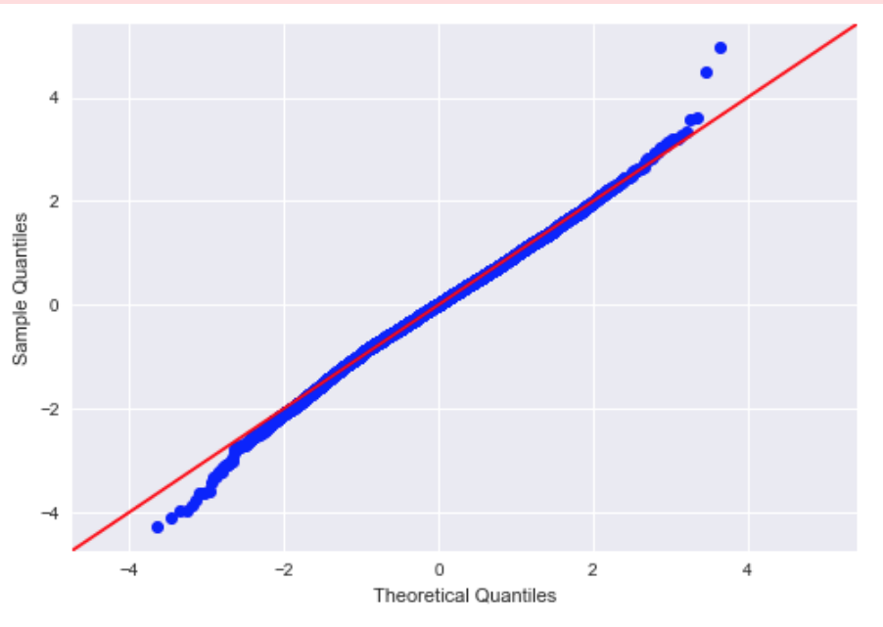
Our Final Model
Model Details:
Price is target feature ($154K to $438K)
11 predictor features
n = 7,212 (train set)
Success Criteria :
r2 = 0.52
RMSE = 50,137 (test)
Cross Validation (8-folds) RMSE = 49,932 (mean)
Top features contributing to the model (t-scores*):
Latitude
Sqft Living Area
63, 49,38, 15
4 of the 6 latitude bands (3, 4, 5, 6)
From 370 to 3,090 sqft
36
-13, -11, -3
Year built
3 of 6 bands (1940 to 2000)
Grade
25
13 & 9
Construction quality: includes grades 5 to 9 (of 13).
Other
Condition (5 levels) and View (4 levels of quality)
* Higher t-scores mean the feature contributes more to the model.

Slide 16
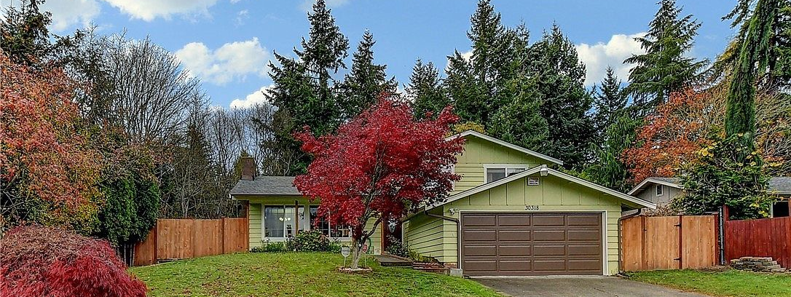
Predicting with the Model (The Salazar’s $316K target price)
Predicting house price +
Example 1: size
1,800 sq. ft living area = $366K
1,000 sq. ft living area = $324K
Example 2: location
Latitude 5 (1,200 sqft) = $365K
Latitude 3 (1,200 sqft) = $256K
Note: +/- $50K (error in our model)
+ from the prediction model, with all other variables held constant (grade 7, condition 3, view 0, yr built 1960 – 80)
A) Size: Each additional sq. ft of living area will add $52 to the home price.*
B) Location: A home in latitude 5 (Seattle) will add ~$135K to the home price versus a home in latitude 1 (south).*
* Based on coefficient values for the feature, when all other features are held constant.

Slide 17
Conclusions

Slide 18

Insights
Key Learnings
Location is a key factor
Living space, quality also important
Iterating is vital to modelling
Limitations of our Model / Approach
Relatively low predictive power; high margin of error
Limiting price range may have hurt model
Data not fulfill all of model assumptions
Over-reliance on categorical data?
Linear regression may not be the best modeling approach for the data

Slide 19

Next Steps
More exploration of location:
transit routes
walkability
proximity to grocery stores
Examine various home types:
duplex
town-homes
condos
Investigate other dwelling / property features:
floor plans
private yard
Parking
Explore impact of Covid-19 on prices and market

Slide 20
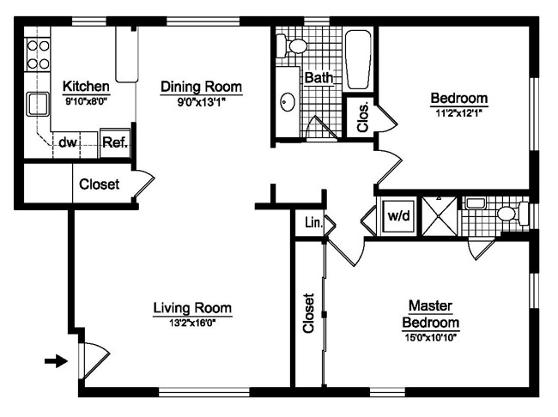
Thanks
Many thanks to:
Flatiron School
Our fearless instructor: Yish Lim
Fill-in instructors: Amber Y., Lindesy B., and Abhineet K.
Our helpful classmates in cohort (onl-ft-092820)
Learn more at: https://github.com/melfriedman/KingHousing
Contact us:
Matthew: mattzhang989@gmail.com
Mark: markpatterson8@hotmail.com
Mel: melfriedman27@gmail.com

